Slide 1
CS 341 Lab 5
Fall 2020

Slide 2
Lab 5
Goal: interface with a Liquid-Crystal Display
Scroll text across the screen
Play noise on a piezo speaker

Slide 3
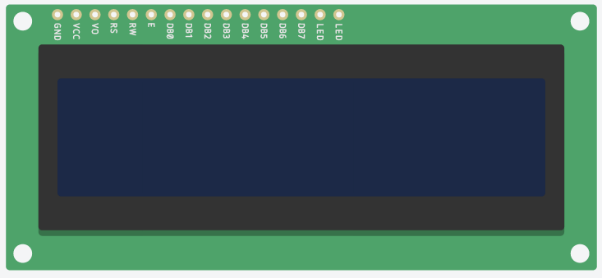
An LCD Screen
Register Selection
Display Contrast
Data mode
Clock
Power
Reading & Writing
Brightness (2 pins)
Ground

Slide 4
<LiquidCrystal.h>
Provides a list of functions to abstract all those pins away
lcd.begin(int columns, int rows);
lcd.setCursor(int column, int row);
lcd.print(char[] data);

Slide 5

Potentiometer
Variable resistor
We can turn the knob to vary how much current goes through
In this lab, we’ll use it to control the contrast

Slide 6

Piezo Speaker
Old fashioned speaker
// turn on the buzzer for a tone =1500 hz
tone(buzzer,1500);
delay(10);
// turn the buzzer off
noTone(buzzer);

Slide 7
Lab 5
Complete the circuit
Implement a circular buffer
“Welcome CS341 Students! ” Then you show:
“elcome CS341 Students! W”. Then you show:
“lcome CS341 Students! We” and so on.

